Slide 1
MODULE 5
OBJECT-BASED DATABASES

Slide 2
Chapter 9: Object-Based Databases
Complex Data Types
Structured Data Types and Inheritance in SQL
Table Inheritance
Array and Multiset Types in SQL
Object Identity and Reference Types in SQL
Implementing O-R Features
Persistent Programming Languages
Object-Oriented vs Object-Relational Databases

Slide 3
Need for Complex Data Types
Traditional database applications had simple data types
Relatively few data types, first normal form
Complex data types have grown more important in recent years
E.g. Addresses can be viewed as a
Single string, or
Separate attributes for each part, or
Composite attributes (which are not in first normal form)
E.g. it is often convenient to store multivalued attributes as-is, without creating a separate relation to store the values in first normal form
Applications
computer-aided design, computer-aided software engineering
multimedia and image databases, and document/hypertext databases.

Slide 4
Object Structure
Loosely speaking, an object corresponds to an entity in the E-R model.
The object-oriented paradigm is based on encapsulating code and data related to an object into single unit.
An object has:
A set of variables that contain the data for the object. The value of each variable is itself an object.
A set of messages to which the object responds; each message may have zero, one, or more parameters.
A set of methods, each of which is a body of code to implement a message; a method returns a value as the response to the message

Slide 5
Class Definition Example
class employee {
/*Variables */ string name; string address; date start-date;
int salary;
/* Messages */
int string string int int
annual-salary(); get-name();
get-address();
set-address(string new-address); employment-length();
};
Methods to read and set the other variables are also needed with strict encapsulation
Methods are defined separately
E.g. int employment-length() { return today() – start-date; }
int set-address(string new-address) { address = new-address;}

Slide 6
Object Classes
Similar objects are grouped into a class
Each individual object is called an instance of its class
All objects in a class have the same
variables, with the same types
message interface
methods
They may differ in the values assigned to variables
e.g., group objects for people into a person class
Classes are analogous to entity sets in the E-R model

Slide 7
Inheritance
Class of bank customers VS class of bank employees
Share some variables and messages, e.g., name and address.
But others are specific to each class
e.g., salary for employees and credit-rating for customers.
Employee and customer are persons
every employee is a person; thus employee is a specialization of person
customer is a specialization of person.
Create classes person, employee and customer
variables/messages applicable to all persons => associate with class person.
variables/messages specific to employees => associate with class employee
similarly for customer

Slide 8
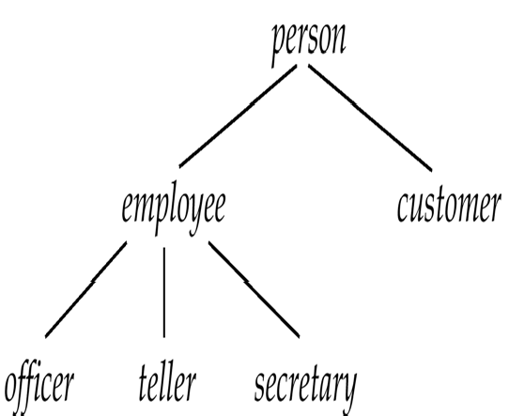
Inheritance (Cont.)
Place classes into a specialization/IS-A hierarchy
variables/messages belonging to class person are inherited by class employee as well as customer
Result is a class hierarchy (or inheritance hierarchy)
Note analogy with ISA Hierarchy in the E-R model

Slide 9
Class Hierarchy Definition
class person{
string
name;
string address:
};
class customer isa person {
int credit-rating;
};
class employee isa person {
date start-date;
int salary;
};
class officer isa employee {
int office-number,
int expense-account-number,
};
.
.
.

Slide 10
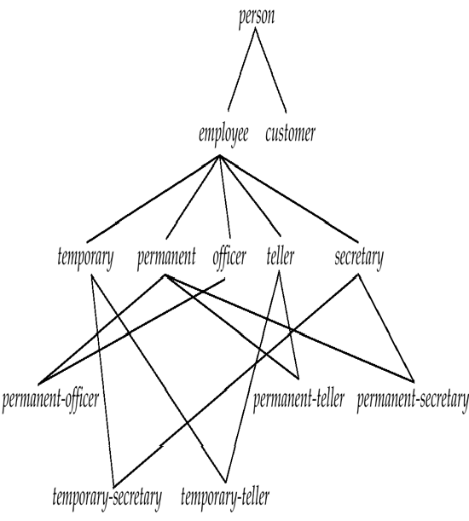
Multiple Inheritance (Example)
Class DAG for banking example.

Slide 11
Multiple Inheritance
A class may have more than one superclass.
Represented by a directed acyclic graph (DAG)
Particularly useful when objects can be classified in more than one way
A class inherits variables and methods from all its superclasses
Potential for ambiguity
when a variable/message N with the same name is inherited from two superclasses A and B
No problem if the variable/message is defined in a shared superclass
Otherwise, do one of the following
flag as an error,
rename variables (A.N and B.N)
choose one.

Slide 12
Object Identity
An object retains its identity even if some or all of the values of variables or definitions of methods change over time.
Object identity is a stronger notion of identity than in programming languages or other data models
Identity by
Value data value; e.g. primary key value used in relational systems.
Name – supplied by user; file names in UNIX
Built-in – identity built into data model or programming language.
no user-supplied identifier is required
the form of identity used in object-oriented systems

Slide 13
Object Identifiers
Object identifiers are used to uniquely identify objects
Object identifiers are unique:
no two objects have the same identifier
each object has only one object identifier
Can be stored as a field of an object, to refer to another object.
E.g., the spouse field of a person object may be an identifier of another person
object.
Can be
system generated (created by database) or
external (such as social-security number)
System generated identifiers:
Are easier to use, but cannot be used across database systems

Slide 14
Object-Relational Model
Extended relational model to support
Nested relations
Complex types
Object orientation
Most commercial DBMS claim to be OR
Oracle, DB2, Informix, …
Relational model
First Normal Form: all attributes have atomic domains
Nested relational model
Domains may be atomic or relation-valued
tuple (complex structure)
set (multiset)

Slide 15
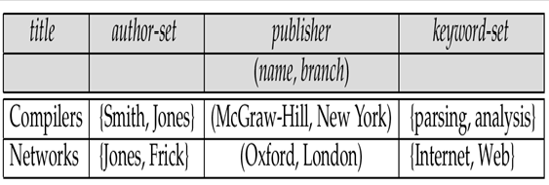
Example of a Nested Relation
Example: library information system
Each book has
title,
a set of authors,
publisher, and
a set of keywords
Non-1NF relation books

Slide 16
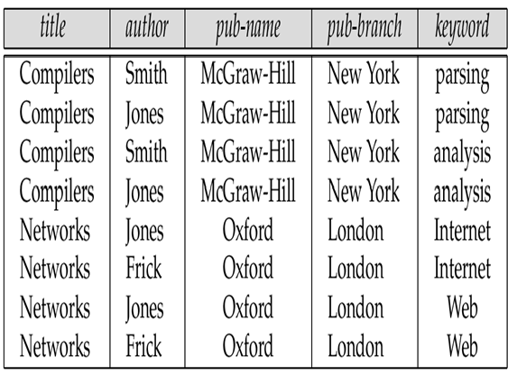
1NF Version of Nested Relation
1NF version of books
flat-books

Slide 17
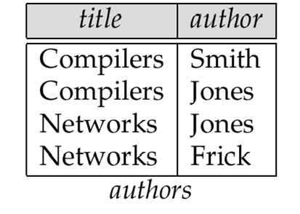
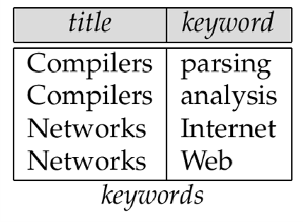
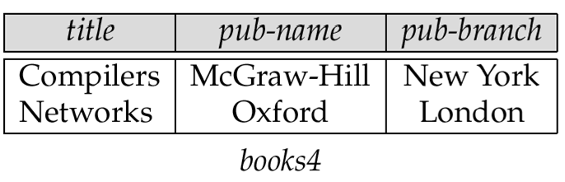
Decomposition
Dependencies in doc
title → → author title → → keyword
(MVD)
title → pub_name, pub_branch
Decomposed version
4NF (BCNF extended to include MVD)
Loose 1-to-1 correspondence between a tuple and a doc
MVD: multi-valued dependency; X → → Y means that a set of Y values is associated
with each X value

Slide 18
Complex Types and SQL:1999
Extensions to SQL to support complex types include:
Collection and large object types
Nested relations are an example of collection types
Structured types
Nested record structures like composite attributes
Inheritance
Object orientation
Including object identifiers and references
Our description is mainly based on the SQL:1999 standard
Not fully implemented in any database system currently
But some features are present in each of the major commercial database systems
Read the manual of your database system to see what it supports

Slide 19
Structured Types and Inheritance in SQL
Structured types can be declared and used in SQL
create type Name as
(firstname lastname final
varchar(20),
varchar(20))
create type Address as
(street city zipcode
varchar(20),
varchar(20), varchar(20))
not final
Note: final and not final indicate whether subtypes can be created
Structured types can be used to create tables with composite attributes
create table customer (
name Name,
address Address, dateOfBirth date)
Dot notation used to reference components: name.firstname

Slide 20
Structured Types (cont.)
User-defined row types
create type CustomerType as (
name Name, address Address, dateOfBirth date) not final
Can then create a table whose rows are a user-defined type
create table customer of CustomerType

Slide 21
Methods
Can add a method declaration with a structured type.
method ageOnDate (onDate date) returns interval year
Method body is given separately.
create instance method ageOnDate (onDate date) returns interval year
for CustomerType
begin
return onDate - self.dateOfBirth;
end
We can now find the age of each customer: select name.lastname, ageOnDate (current_date) from customer

Slide 22
Inheritance
Suppose that we have the following type definition for people:
create type Person (name varchar(20), address varchar(20))
Using inheritance to define the student and teacher types
create type Student
under Person
(degree varchar(20),
department varchar(20)) create type Teacher under Person
(salary integer,
department varchar(20))
Subtypes can redefine methods by using overriding method in place of method in the method declaration

Slide 23
Multiple Inheritance
SQL:1999 and SQL:2003 do not support multiple inheritance
If our type system supports multiple inheritance, we can define a type for teaching assistant as follows:
create type Teaching Assistant
under Student, Teacher
To avoid a conflict between the two occurrences of department we
can rename them
create type Teaching Assistant
under
Student with (department as student_dept ),
Teacher with (department as teacher_dept )

Slide 24
Object-Identity and Reference Types
An attribute can be a reference to a tuple in a table
Define a type Department with a field name and a field head which is a reference to the type Person, with table people as scope:
create type Department (
name varchar (20),
head ref (Person) scope people)
We can then create a table departments as follows
create table departments of Department
We can omit the declaration scope people from the type declaration and instead make an addition to the create table statement:
create table departments of Department
(head with options scope people)

Slide 25
Initializing Reference-Typed Values
To create a tuple with a reference value, we can first create the tuple with a null reference and then set the reference separately:
insert into departments
values (`CS’, null)
update departments
set head = (select p.person_id
from people as p
where name = `John’)
where name = `CS’

Slide 26
Path Expressions
Dot (.) notation is used for composite attributes
select title, publisher.name
from books
Pointer (->) notation is used for reference attributes
select head->name, head->address
from departments
references can be used to hide join operations

Slide 27
Collection-Valued Attributes
Can be treated much like relations, using the keyword unnest
The books relation has array-valued attribute author-array and set-valued attribute keyword-set
Find all books that have the word “database” as keyword
select title
from books
where ‘database’ in (unnest(keyword-set))
Note: the only collection type supported by SQL:1999 is the array type
To get a relation containing pairs of the form title, author-name for each book and each author of the book
select B.title A
from books as B, unnest(B.author-array) as A
“ ”

Slide 28
Collection Valued Attributes (Cont.)
We can access individual elements of an array by using indices
E.g. If we know that a particular book has three authors, we could write:
select author-array[1], author-array[2], author-array[3]
from books
where title = `Database System Concepts’

Slide 29
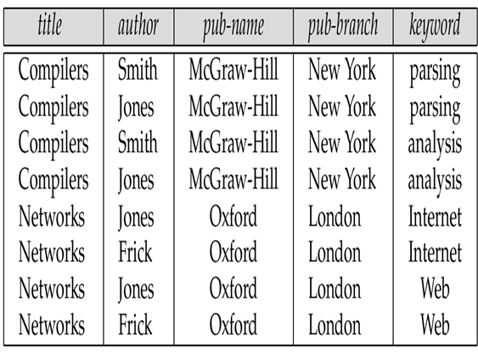
Unnesting
The transformation of a nested relation into a form with fewer (or no) relation-valued attributes
select title, A as author, publisher.name as pub_name, publisher.branch as pub_branch, K as keyword
from books as B, unnest(B.author-array) as A,
unnest (B.keyword-list) as K

Slide 30
Nesting
Opposite of unnesting: creates a collection-valued attribute
NOTE: SQL:1999 does not support nesting
Similar to aggregation, but using the function set()
select title, author, Publisher(pub_name, pub_branch) as publisher,
set(keyword) as keyword-list
from flat-books
group by title, author, publisher
select title, set(author) as author-list, Publisher(pub_name, pub_branch) as publisher, set(keyword) as keyword-list
from flat-books
group by title, publisher

Slide 31
Nesting (Cont.)
Another approach to creating nested relations is to use subqueries in the select clause.
select title,
( select author
from flat-books as M
where M.title=O.title) as author-set, Publisher(pub-name, pub-branch) as publisher, (select keyword
from flat-books as N
where N.title = O.title) as keyword-set
from flat-books as O

Slide 32
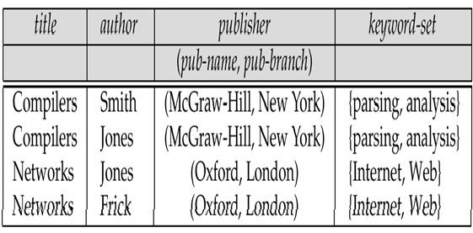
Nesting & Unnesting
Unnesting
select title, A as author, publisher.name as pub_name, publisher.branch as pub_branch, K as keyword
Nesting
select title, author, (pubname, pubbranch) as
publisher, set(keyword) as keyword_list
from flat_docs
from doc as B, unnest(B.author_list) as A,
unnest(B.keyword_set) as K
group by title, author, publisher
result is shown below
result is flat_books

Slide 33
Object-Oriented Languages
Object-oriented concepts can be used in different ways
Object-orientation can be used as a design tool
and then encode into, for example, a relational database
analogous to modeling data with E-R diagram and then converting to a set of relations
Object orientation can be incorporated into a programming language that is used to manipulate the database.
Object-relational systems – add complex types and object-orientation to relational language
Persistent programming languages – extend object-oriented programming language to deal with databases by adding concepts such as persistence and collections.

Slide 34
Persistent Programming Languages
Persistent Programming languages
allow objects to be created and stored in a database,
and used directly from a programming language
Allow data to be manipulated directly from the programming language
No need to go through SQL
No need for explicit format (type) changes
Drawbacks
Flexibility and power of programming languages => it is easy to make programming errors that damage the database
Complexity of languages makes automatic optimization more difficult
Do not support declarative querying as well as relational databases

Slide 35
OO vs OR
OO
efficient in complex main memory operations of persistent data
susceptible to data corruption
OR
declarative and limited power of (extended) SQL (compared to PL)
data protection and good optimization
extends the relational model to make modeling and querying easier
Relational
simple data types, good query language, high protection

